Slide 1
Challenge 2 (SQL Case Study) Esports Tournament
(Tool – SQLite)
Presented By – Rupali patil more

Slide 2
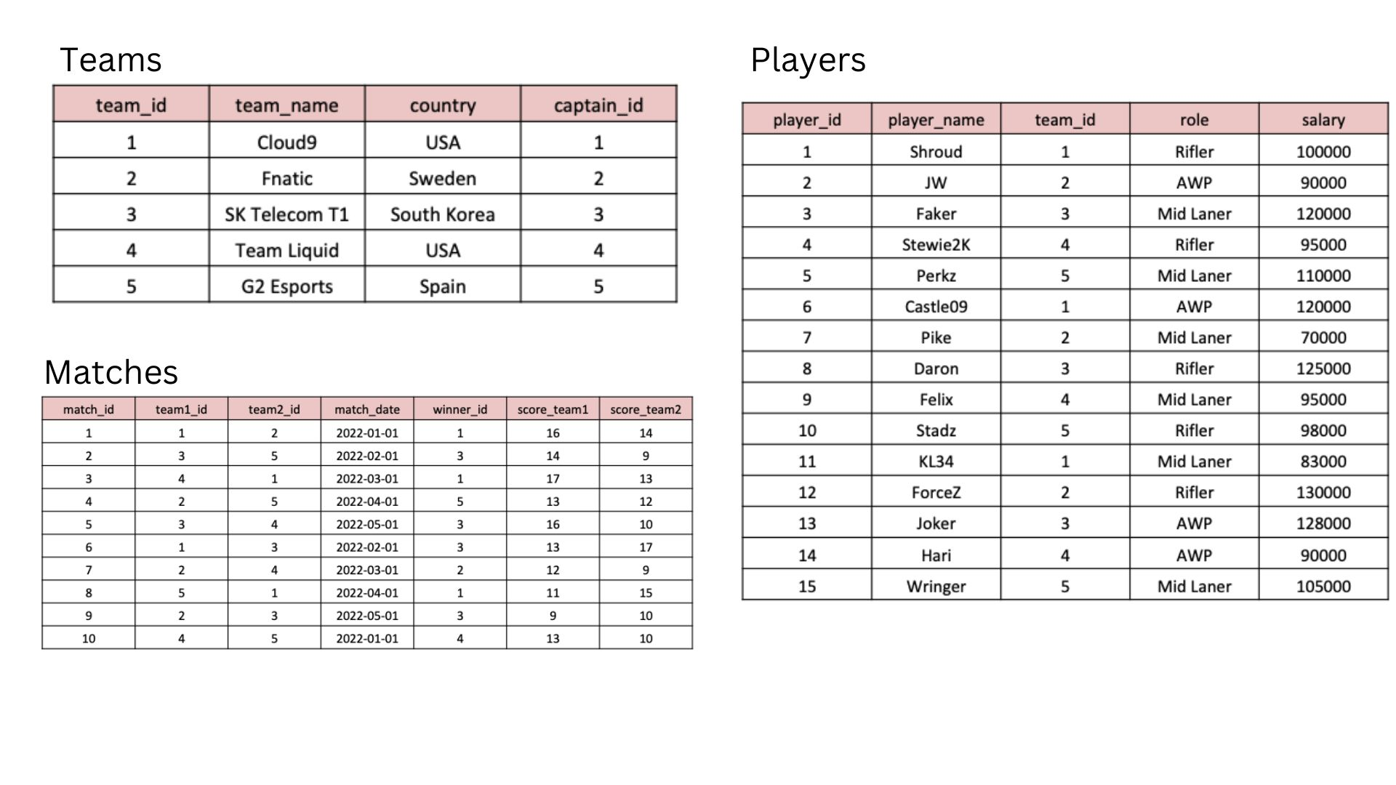
INTRODUCTION
Dataset Used
Team
Players
Matches
The top esports competitors from across the globe have gathered to battle it out
analyze the following data to find out all about the tournament?

Slide 3
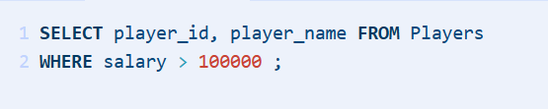
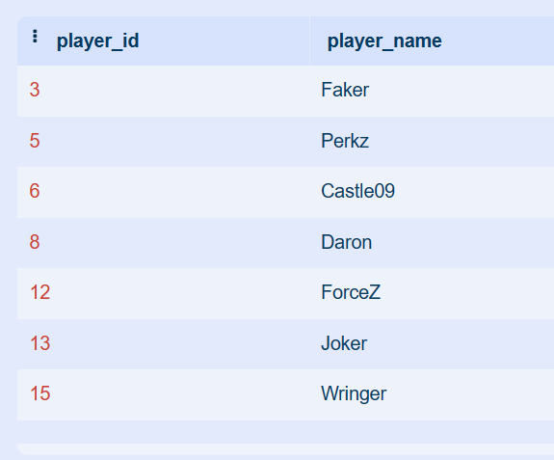
Q.1 What are the names of the players whose salary is greater than 100,000?
Query
Output

Slide 4
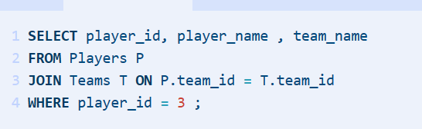
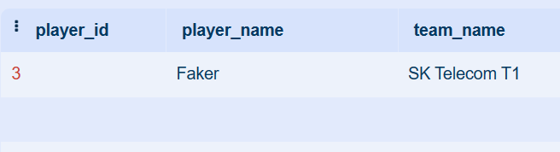
Q.2 What is the team name of the player with player_id = 3?
Query
Output

Slide 5
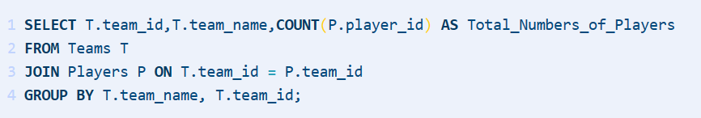
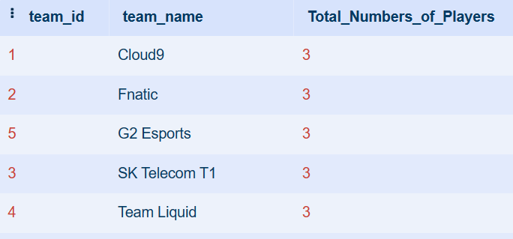
Q.3 What is the total number of players in each team?
Query
Output

Slide 6
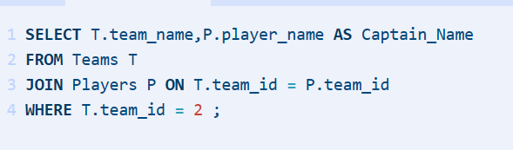
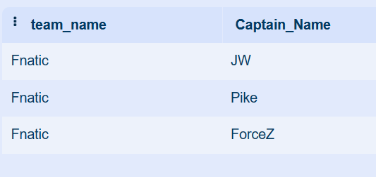
Q.4 What is the team name and captain name of the team with team_id = 2?
Query
Output

Slide 7
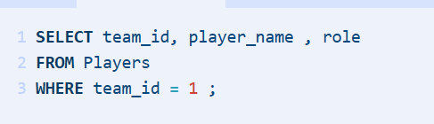
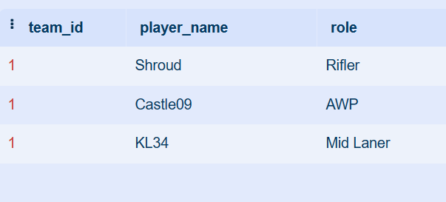
Q.5 . What are the player names and their roles in the team with team_id = 1?
Query
Output

Slide 8
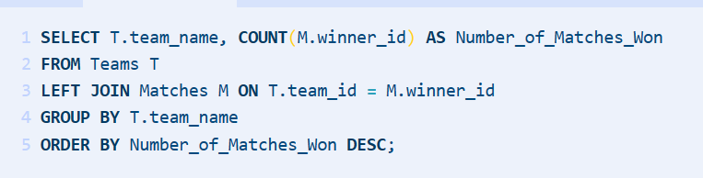
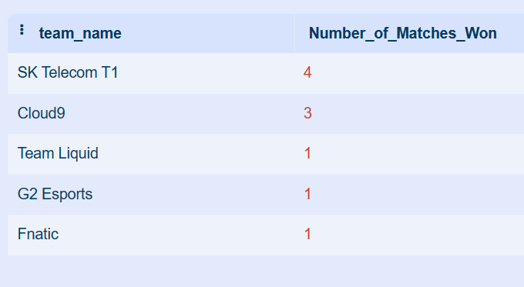
Q. 6 What are the team names and the number of matches they have won?
Query
Output

Slide 9
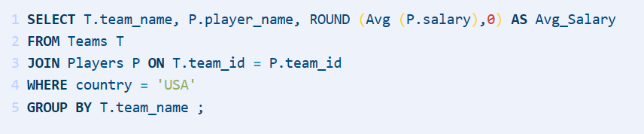
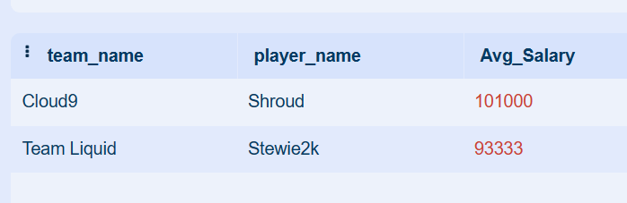
Q. 7 What is the average salary of players in the teams with country 'USA'?
Query
Output

Slide 10
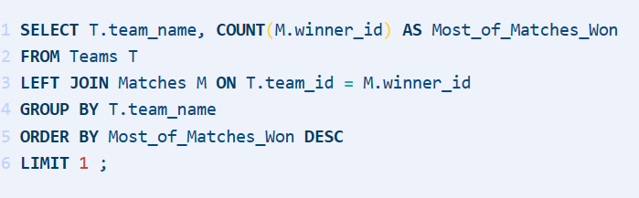
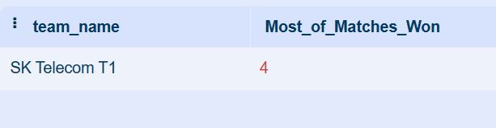
Q. 8 Which team won the most matches?
Query
Output

Slide 11
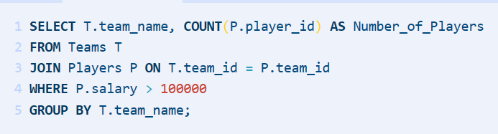
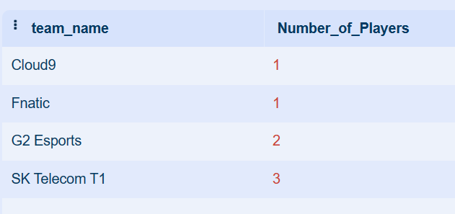
Q. 9 What are the team names and the number of players in each team whose salary is greater than 100,000?
Query
Output

Slide 12
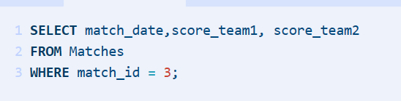
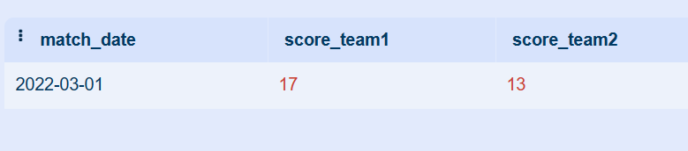
Q. 10 What is the date and the score of the match with match_id = 3?
Query
Output

Slide 13
THANK YOU
Rupali patil more
rupali3patil@gmail.com

